Slide 1

Source Code & GitHub Repository: MaidEase
Team 1 - Rushda Mansuri Tahera Shaikh Nidhi Berde Amala Natu Bhakti Palkar Jahid Hassan Sai Manish Avasarala Sai Teja Malladi

Slide 2


GitHub URL
https://github.com/RushdaMansuri/Maid-Ease

Slide 3

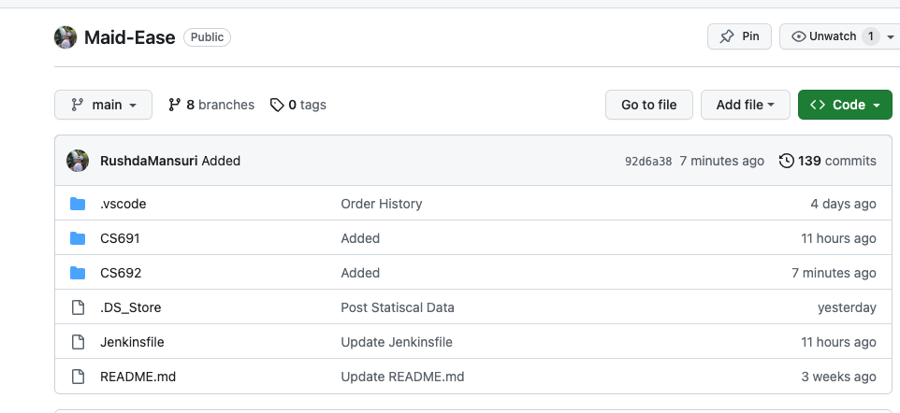
Repository Structure

Slide 4
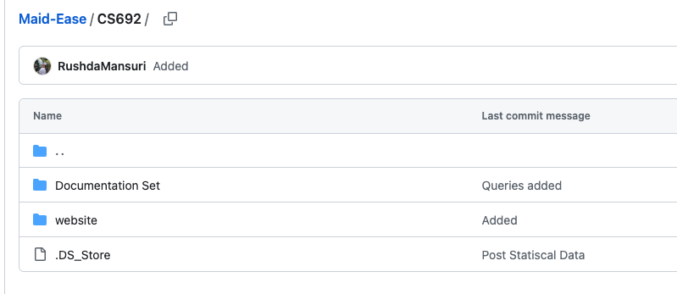

Repository Structure - Code
URL: https://github.com/RushdaMansuri/Maid-Ease/tree/main/CS692

Slide 5

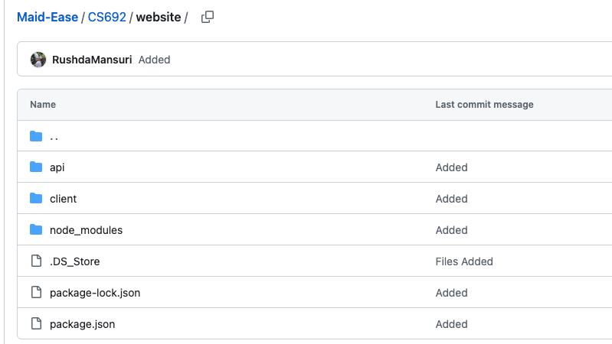
--
Repository Structure – Code (Code-base)
URL: https://github.com/RushdaMansuri/Maid-Ease/tree/main/CS692/website

Slide 6
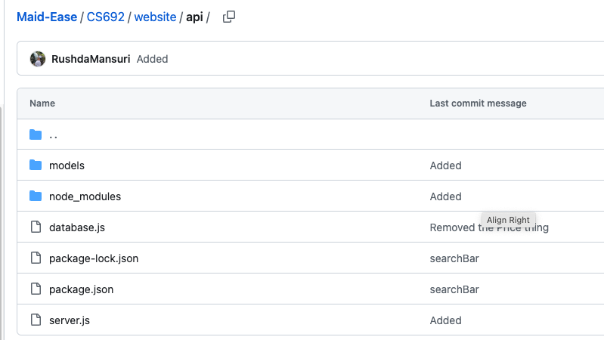
--
Repository Structure – Code (Code-base – Serverside)
URL: https://github.com/RushdaMansuri/Maid-Ease/tree/main/CS692/website/api

Slide 7
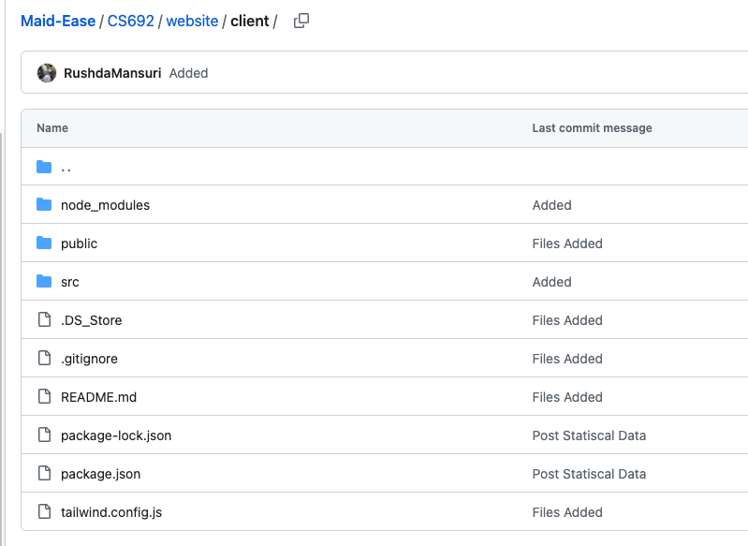
--
Repository Structure – Code (Code-base – Serverside)
URL: https://github.com/RushdaMansuri/Maid-Ease/tree/main/CS692/website/client

Slide 8





Front-End Technologies

Slide 9

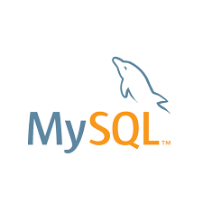



Back-End Technologies

Slide 10

Build & Deployment Procedures

Slide 11
Prerequisites
Step 1: Install Node.js
To install Node.js, visit the official Node.js website for download instructions: Node.js Download
Step 2: Install MySQL Workbench
Download and install MySQL Workbench from the official MySQL website: MySQL Workbench Download
Step 3: Install ReactJS, Node.js, and Express Once you've installed Node.js, you can proceed to install ReactJS, Node.js, and Express using the following commands:
npm install -g create-react-app
npm install -g npm
npm i express
node -v
npm -v

Slide 12
Installation Steps
Clone this repository (https://github.com/RushdaMansuri/Maid-Ease.git) to your local machine.
Open the server folder in command line and run the following command:
npm install express cors body-parser jsonwebtoken mysql nodemailer nodemon –save
Open the client folder in command line and run the following command: npm install --save react react-router-dom react-native @material-ui/icons axios
Run the sql script (Queries.sql) in your MySQL client
Check and change the username, password, etc MySQL credentials in server.js in server folder.
Go to server folder in Powershell and enter the following command: nodemon server.js
Go to client folder in Powershell and enter the following command: npm start

Slide 13
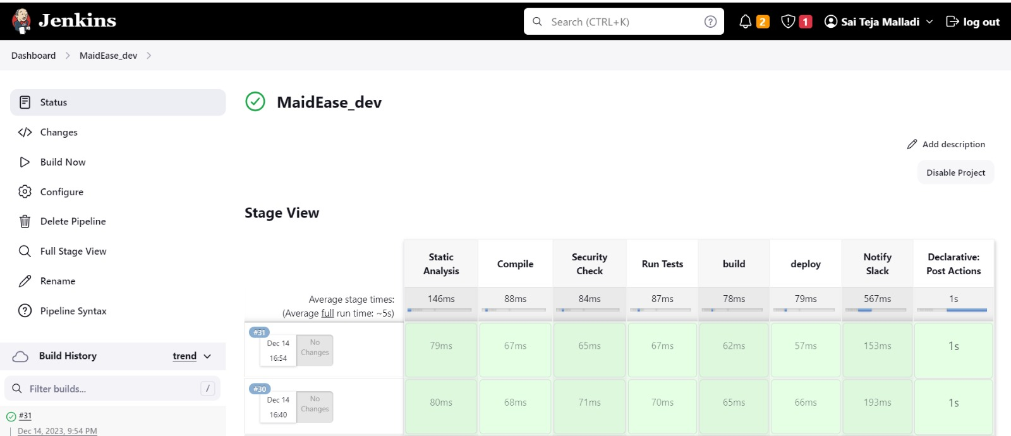
Jenkins-Dev Pipeline

Slide 14
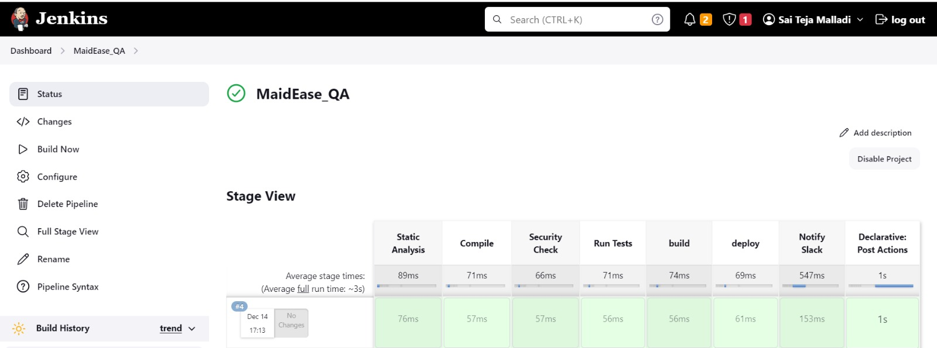
Jenkins-QA Pipeline

Slide 15

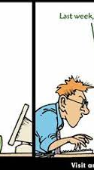
Source Code

Slide 16
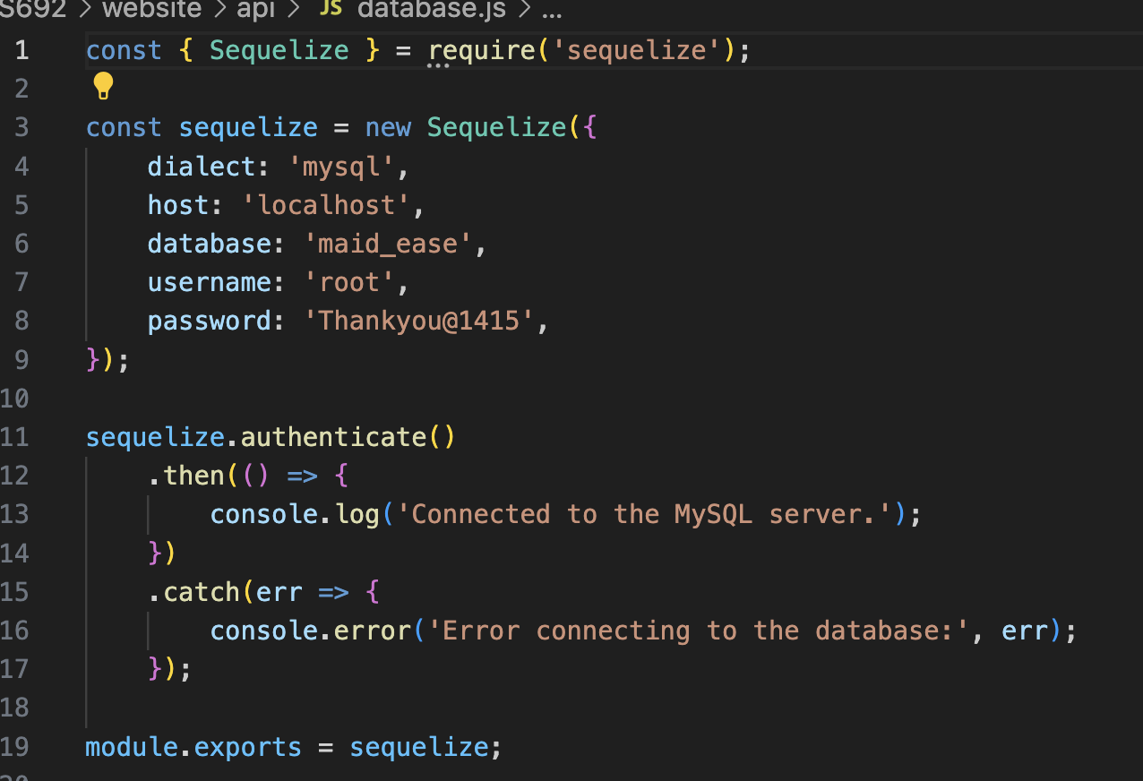
Database connection

Slide 17
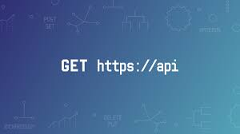
API Calls

Slide 18
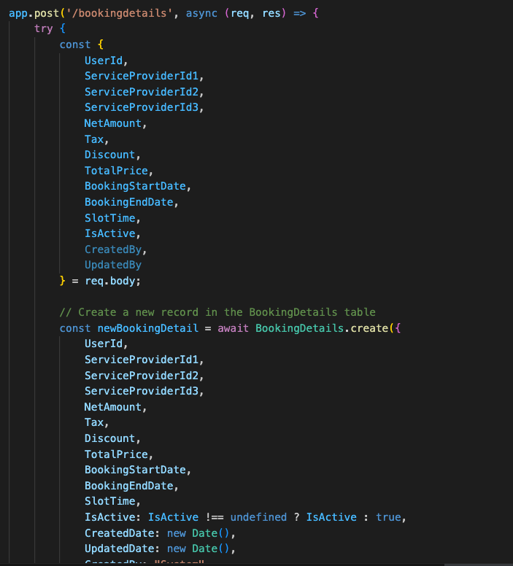
ModifyAppointment/Insert

Slide 19
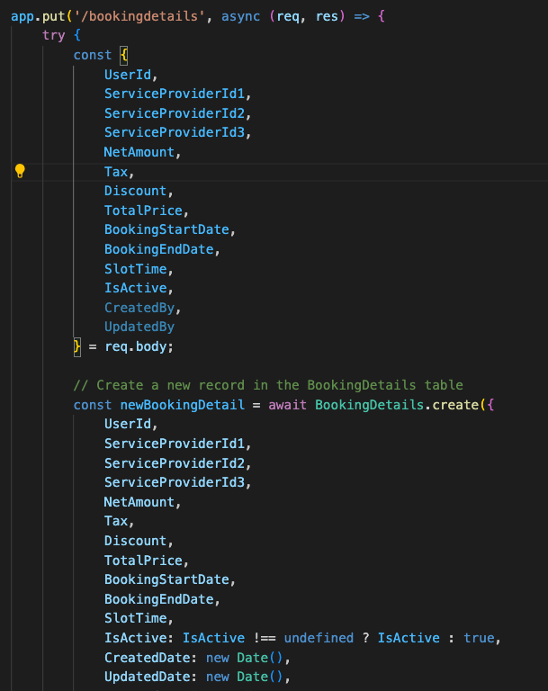
ModifyAppointment/Edit

Slide 20
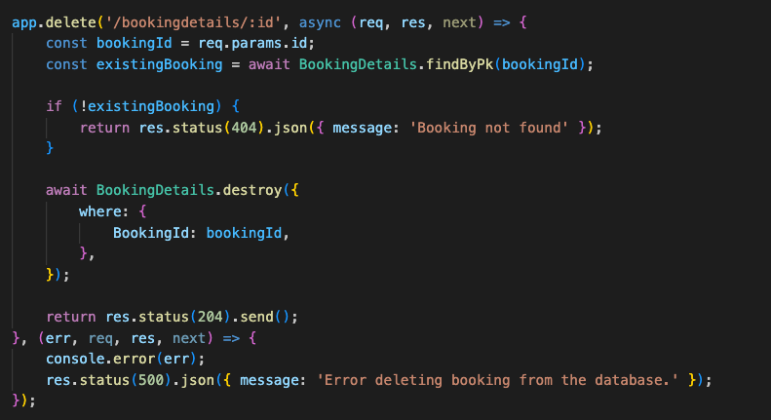
CancelAppointment

Slide 21
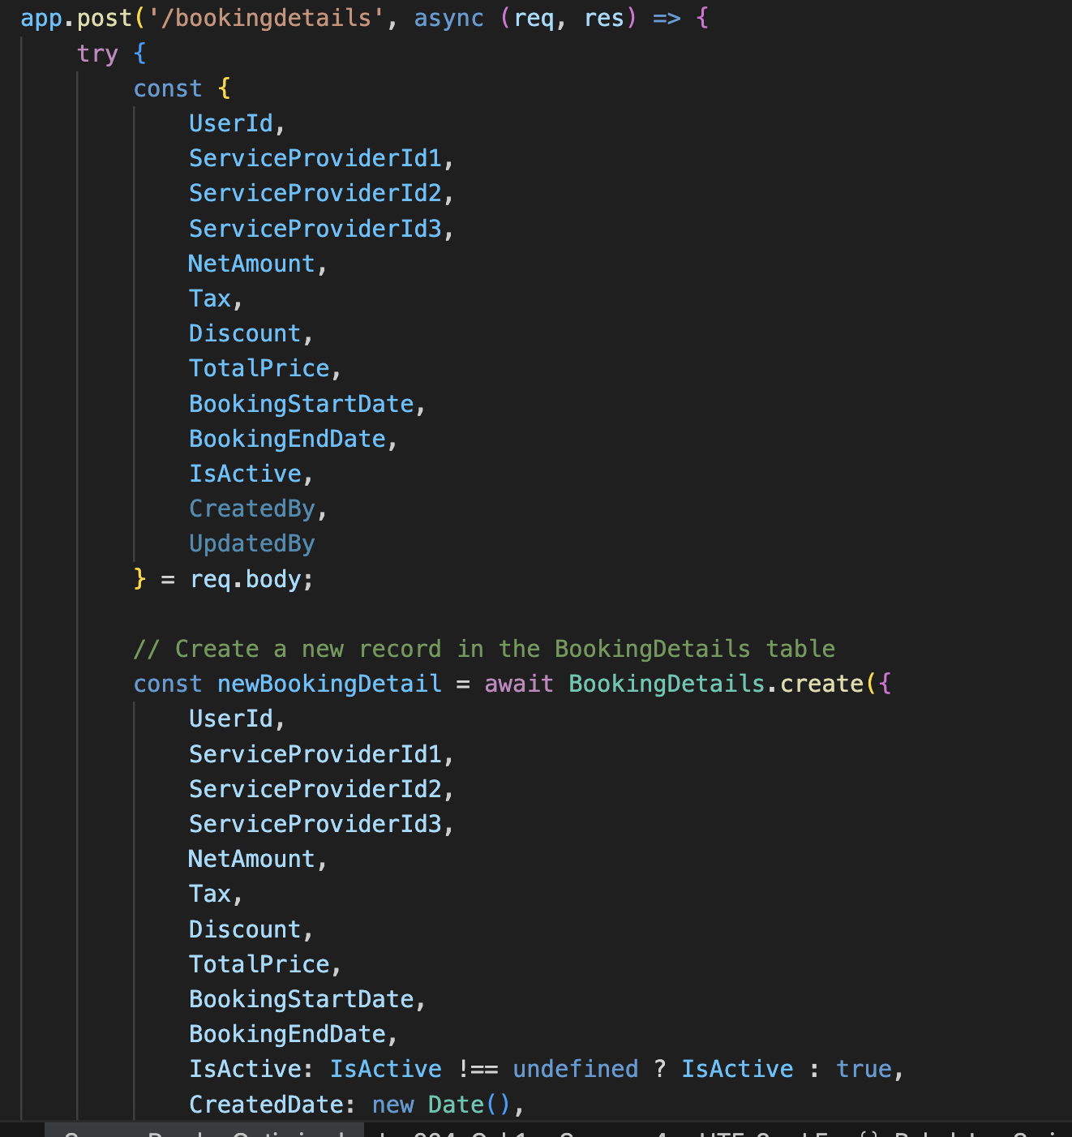
BookingConfirmation

Slide 22
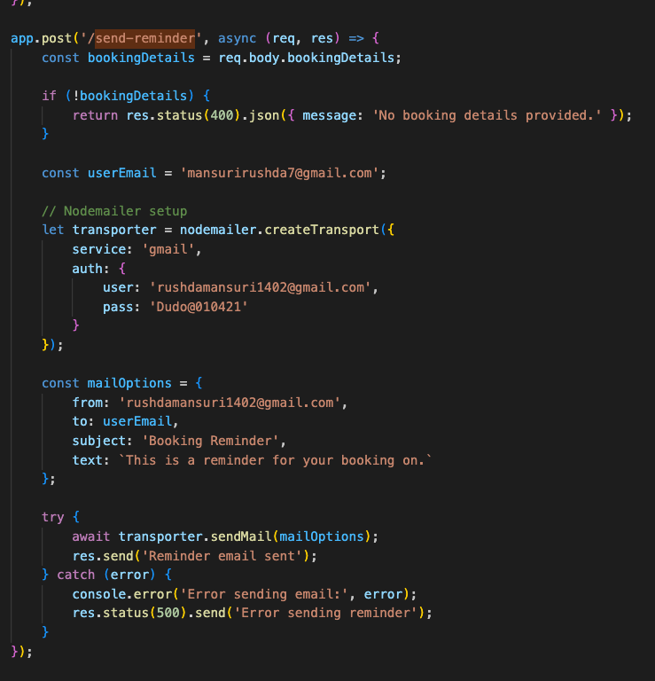
SendReminder

Slide 23
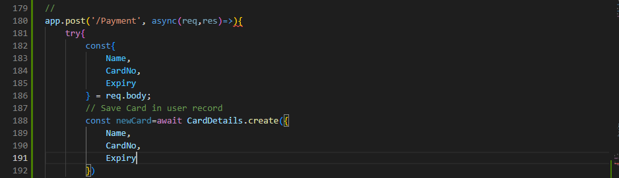
Payment – Insert users card details

Slide 24


UI/ UX (Homepage, Login, Register, Profile, Edit, Delete)

Slide 25
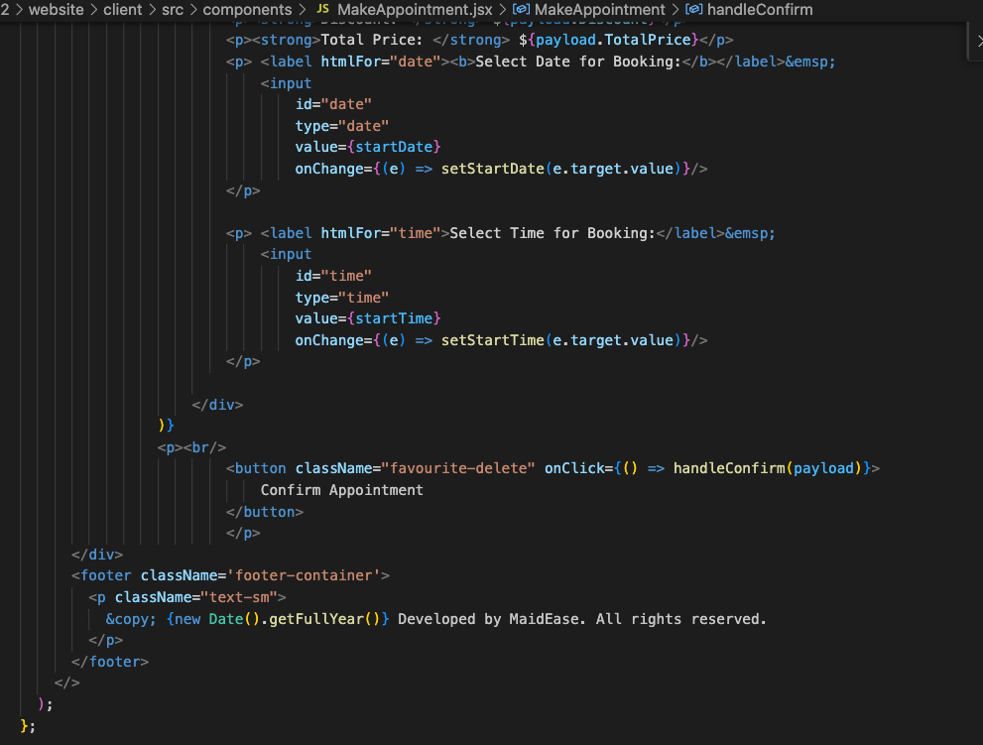
Modify Appointment

Slide 26
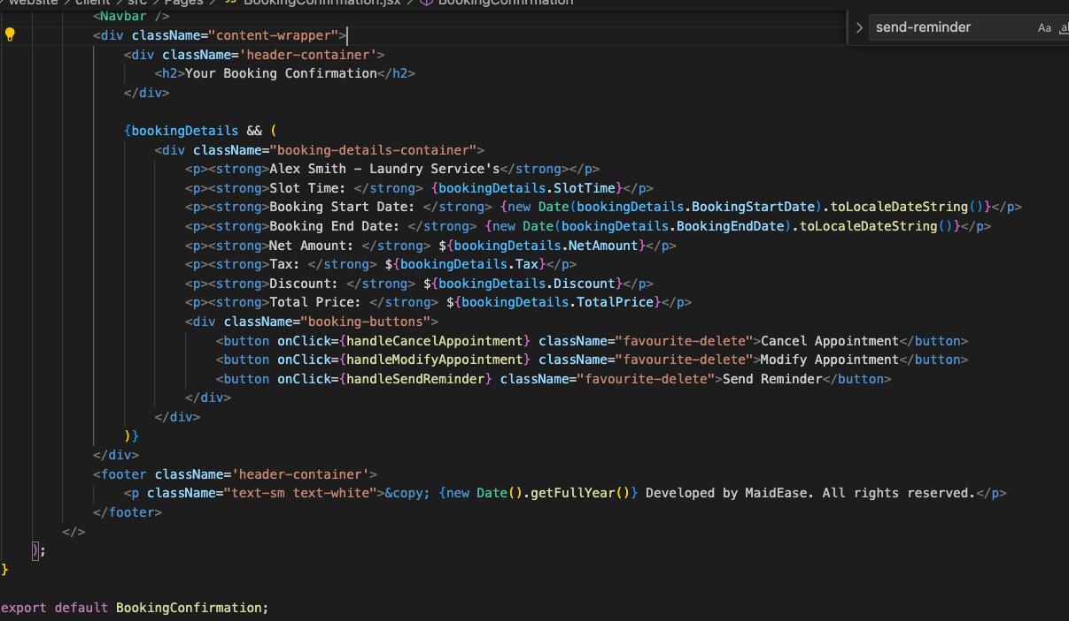
BookingConfirmation

Slide 27
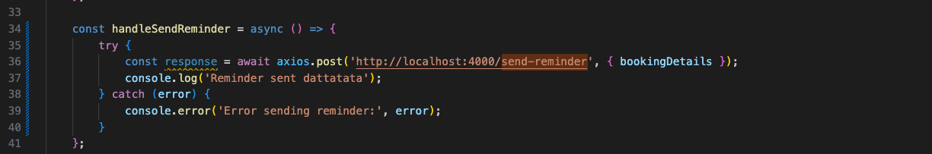
SendRemainder

Slide 28
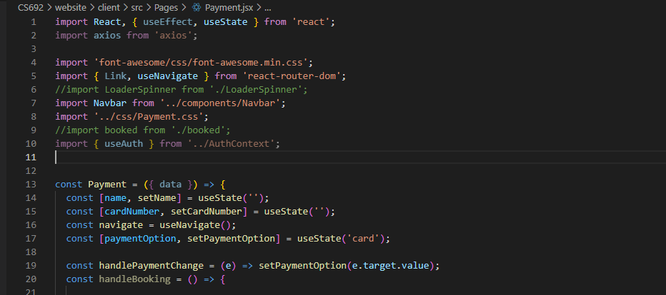
Payment

